Slide 1
Distributed Computing Peer-to-Peer Computing and Overlay Graphs
Dr. Barsha Mitra
CSIS Dept, BITS Pilani, Hyderabad Campus

Slide 2
Introduction
peer-to-peer (P2P) network systems use an application-level organization of the network overlay
allows for flexibly sharing resources (e.g., files and multimedia documents) stored across network-wide computers
any node in a P2P network can act as a server to others and also as a client
communication and exchange of information is performed directly between the participating peers
relationships between the nodes in the network are equal

Slide 3
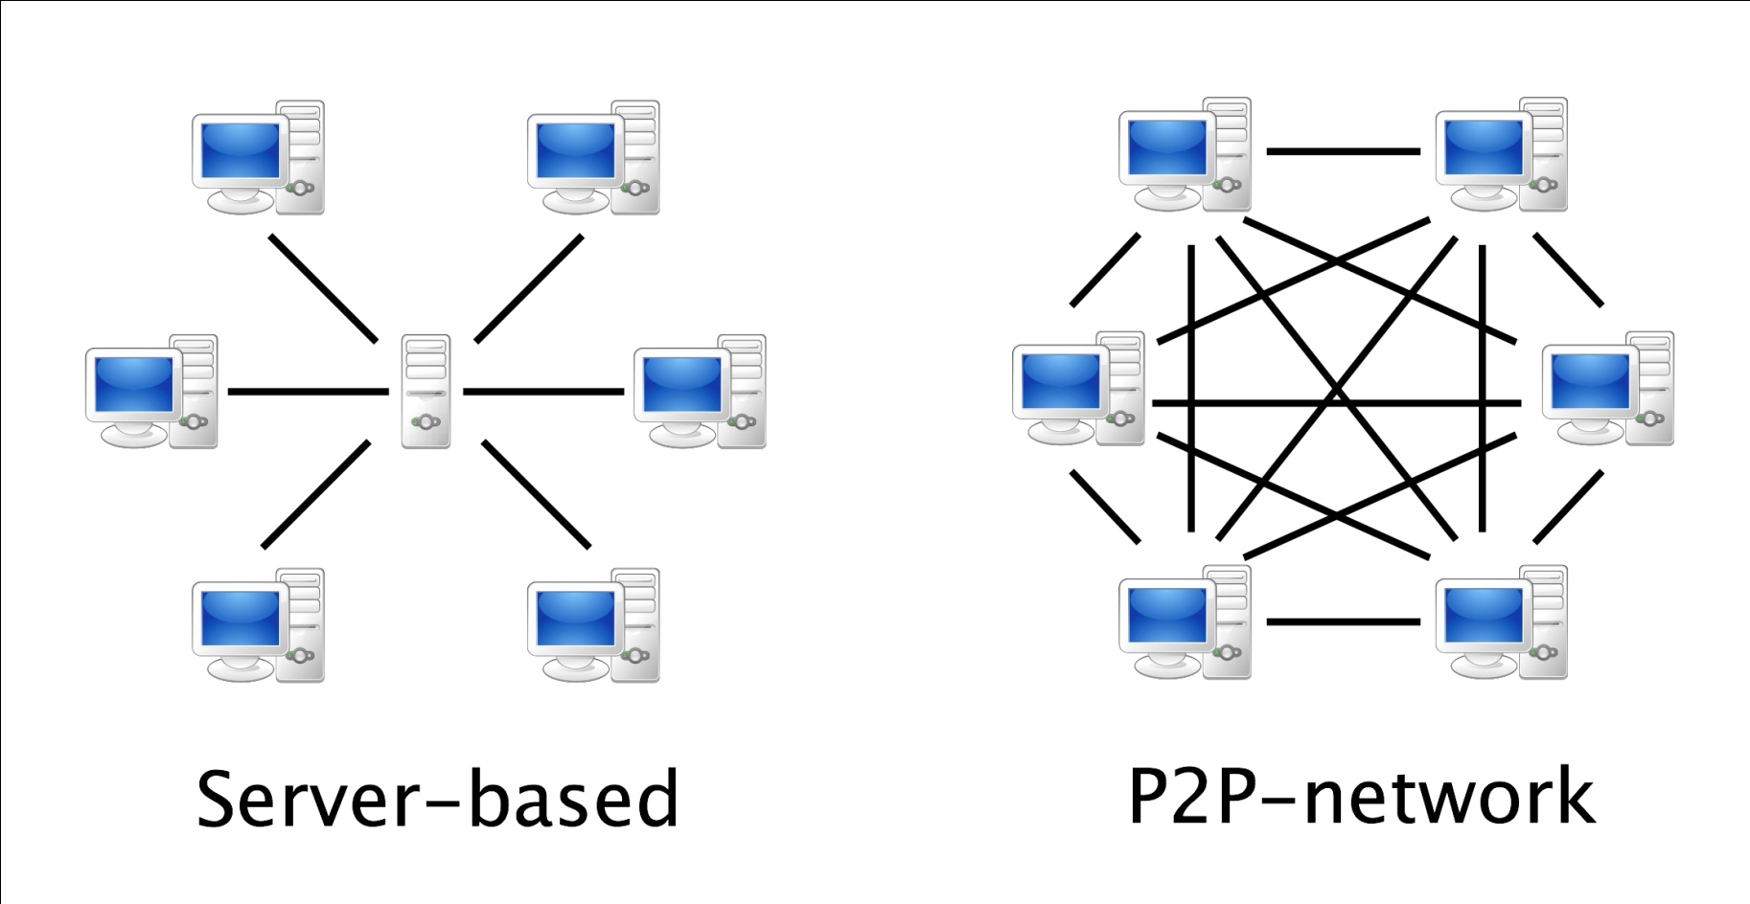
Introduction
source: http://www.terndrup.net/2015/10/27/Building-a-P2P-Peer-Client-with-Node-js/

Slide 4
Introduction
well known P2P networks that allow P2P file-sharing
Napster
Gnutella
Freenet
Pastry
Chord
CAN

Slide 5
Introduction
P2P networks
allow the location of arbitrary data objects
impose a low cost for scalability, and for entry into and exit from the network
ongoing entry and exit of various nodes and dynamic insertion and deletion of objects is termed as churn
impact of churn should be as transparent as possible

Slide 6
Introduction
exhibit a high level of self-organization
are able to operate efficiently despite the lack of any prior infrastructure or authority
if a node wants to enjoy the services which other nodes provide, that node should provide service to other nodes

Slide 7
Data Indexing and Overlays
data in a P2P network is identified by using indexing
indexing mechanisms can be classified as:
centralized
local
distributed

Slide 8
Data Indexing and Overlays
Centralized Indexing:
use of one or a few central servers to store references (indexes) to the data on many peers
eg. Napster
Local indexing:
requires each peer to index only the local data objects
remote objects need to be searched for
used in unstructured overlays in conjunction with flooding search or random walk search
Gnutella uses local indexing

Slide 9
Data Indexing and Overlays
Distributed Indexing:
involves the indexes to the objects at various peers being scattered across other peers throughout the P2P network
distributed indexing is the most challenging of the indexing schemes
many novel mechanisms have been proposed, most notably the distributed hash table (DHT)

Slide 10
Data Indexing and Overlays
Distributed Indexing:
DHT uses a flat key space to associate the mapping between network nodes and data objects/files/values
node address is mapped to a logical identifier in the key space using a consistent hash function
data object/file/value is also mapped to the same key space using hashing

Slide 11
Data Indexing and Overlays
Distributed Indexing:

Slide 12
Structured Overlays
P2P network topology has a definite structure
placement of files or data in this network is highly deterministic as per some algorithmic mapping
objective is to allow a very fast and deterministic lookup to satisfy queries for the data
use a hash table interface for the mapping
hash function maps keys to values
this mapping in conjunction with the regular structure of the overlay allows fast search for the location of a file

Slide 13
Structured Overlays
mapping of a file to a location can be based on a single characteristic of the file
name
length
overhead incurred by file insertions and deletions may be non-trivial under churn
disadvantage of such mapping:
arbitrary queries such as range queries, attribute queries and exact keyword queries cannot be handled directly

Slide 14
Unstructured Overlays
P2P network topology does not have any particular controlled structure
no control over where files/data is placed
each peer indexes only its local data objects
local indexing is used
node joins and departures are easy – the local overlay is simply adjusted
file placement is not governed by the topology
search for a file may have high message overhead and high delays
complex queries are supported because the search criteria can be arbitrary

Slide 15
Unstructured Overlays: Properties
disadvantages
queries may take a long time to find a file
queries may be unsuccessful even if the queried object exists
message overhead of a query search may also be high
advantages
exact keyword queries, range queries, attribute-based queries, and other complex queries can be supported
can accommodate high churn
search is efficient for not-so-large networks

Slide 16
Gnutella
message types used by Gnutella:
Ping messages –
used to discover hosts
allow a new host to announce itself
Pong messages –
responses to Pings
indicate the port and IP address of the responder, and some information about the amount of data (the number and size of files) that node can make available

Slide 17
Gnutella
message types used by Gnutella:
Query messages –
contain a search string and the minimum download speed required of the potential responder
flooded in the network
QueryHit messages –
sent as responses if a node receiving a Query detects a local match in response to a query
contains the port, IP address, speed, the number of files found, and related information
path traced by a Query is recorded in the message, so the QueryHit follows the same path in reverse

Slide 18
Search in Gnutella and Unstructured Overlays
Guided Search versus Unguided Search
unguided or blind search
there is no history of earlier searches
each search is inherently independent
guided search
nodes store some history of past searches to aid future searches
various mechanisms for caching hints to guide and narrow down future searches are used

Slide 19
Search Strategies
Flooding
to curtail the high message overhead that flooding introduces, checking can be used
a node checks back with the query originator before forwarding a query
causes heavy load on the originator, in addition to excessive delays
not practical

Slide 20
Search Strategies
Flooding
use the time to live (TTL) field or the hop count
does not guarantee that a match can be found for the query even if the object exists in the network
requires a high value of TTL to have a high degree of success
Random walk
a query is randomly forwarded by a node when it is received
greatly reduces the message overhead
increases the search latency

Slide 21
Chord distributed hash table: Overview
proposed by Stoica et al.
uses a flat key space to associate the mapping between network nodes and data objects/files/values
node address and data object/file/value is mapped to a logical identifier in the common key space using a hash function
equal distribution of keys among nodes

Slide 22
Chord distributed hash table: Overview
Chord key space is flat
supports a single operation, lookup(x)
lookup(x) maps a given key x to a network node
Chord stores a file/object/value at the node to which the file/object/value’s key maps
2 steps are involved:
1. Map the object/file/value to its key in the common address space.
2. Map the key to the node in its native address space using lookup.

Slide 23
Chord distributed hash table: Overview
node’s IP address is hashed to an m-bit identifier that serves as the node identifier in the common key (identifier) space
file/data key is hashed to an m-bit identifier that serves as the key identifier
identifier space is ordered on the logical ring modulo 2^{m}
a key k gets assigned to the first node such that its node identifier equals or follows the key identifier of k in the common identifier space
node is the successor of k, denoted succ(k)

Slide 24
Chord distributed hash table: Overview
Chord ring for m = 7
6 keys, K8, K15, K28, K53, K87, and K121, are stored among these nodes as follows:
succ(8) = 18
succ(15) = 18
succ(28) = 28
succ(53) = 63
succ(87) = 99
succ(121) = 5
Convention:
(x, y] → left-open right-closed segment of the Chord ring

Slide 25
Simple Lookup
(variable)
integer: successor ← initial value;
(1) i.Locate_Successor(key), where key ≠ i:
(1a) if key ∈ (i, successor] then
(1b) return (successor)
(1c) else return (successor.Locate_Successor(key)).

Slide 26
Simple Lookup

Slide 27
Scalable Lookup
each node i maintains a routing table, called finger table
x^{th} entry (1 ≤ x ≤ m) is the node identifier of the node succ(i+2^{x−1})
this is denoted by i.finger[x] = succ(i+2^{x−1})
size of the finger table is bounded by m entries
search is highly scalable
for a query on key key at node i, if key lies between i and its successor, then key would reside at the successor and the successor’s address is returned
else the finger table is searched
(variables)
integer: successor ← initial value;
integer: predecessor ← initial value;
integer: finger[1…m];

Slide 28
Scalable Lookup
(1) i.Locate_Successor(key), where key ≠ i:
(1a) if key ∈ (i, successor] then
(1b) return (successor)
(1c) else
(1d) j ← Closest_Preceding_Node(key);
(1e) return (j.Locate_Successor(key))
(2) i.Closest_Preceding_Node(key), where key ≠ i:
(2a) for count = m down to 1 do
(2b) if finger[count] ∈ (i, key] then
(2c) break();
(2d) return (finger[count])

Slide 29
Scalable Lookup

Slide 30
References
Ajay D. Kshemkalyani, and Mukesh Singhal, Chapter 18, “Distributed Computing: Principles, Algorithms, and Systems”, Cambridge University Press, 2008.

Slide 31
Thank You

